Slide 1

Scifor Technologies
Sahil Bhandari
STB03-T0031
Mini Project
Olympics Data Analysis

Slide 2

Power-BI
Power BI is a business analytics tool by Microsoft that empowers users to visualize and share insights from their data. With intuitive dashboards, interactive reports, and a user-friendly interface
Power BI empowers users to visualize and analyze data, enabling informed decision-making across organizations

Slide 3
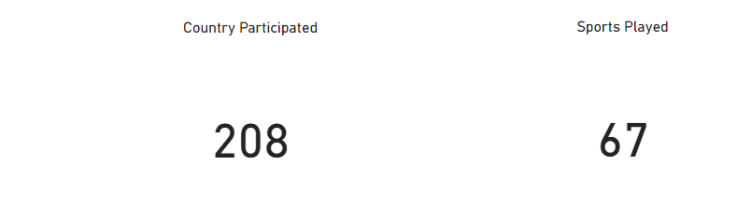
The Olympic Games, with roots dating back to ancient Greece, represent a centuries-old tradition celebrating athletic excellence and international unity.
The modern Olympic Games were revived in 1896 by Pierre de Coubertin, with the inaugural event held in Athens.

Slide 4
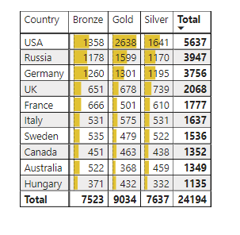
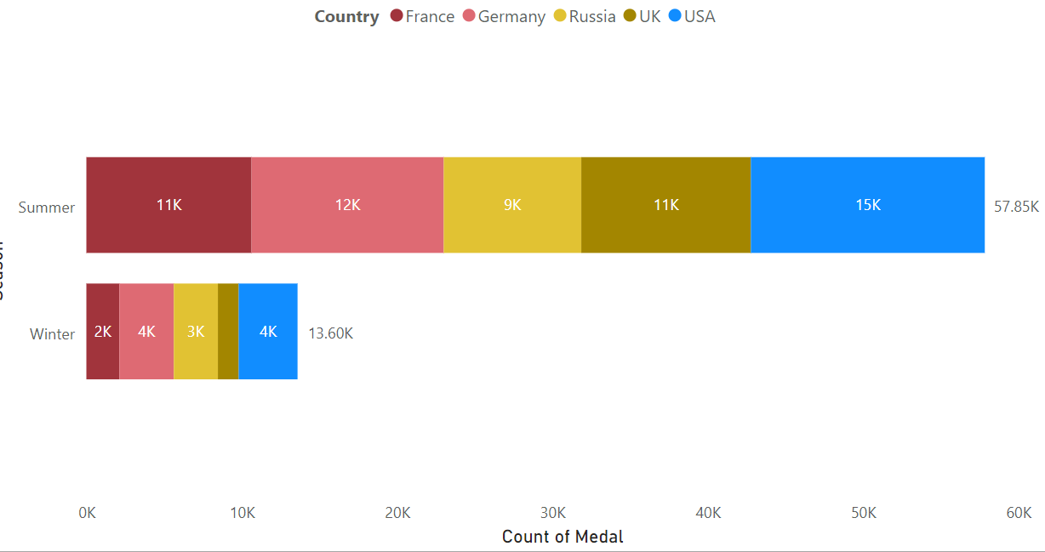
Numbers of medals won by country
Number of Medals won Season Wise

Slide 5
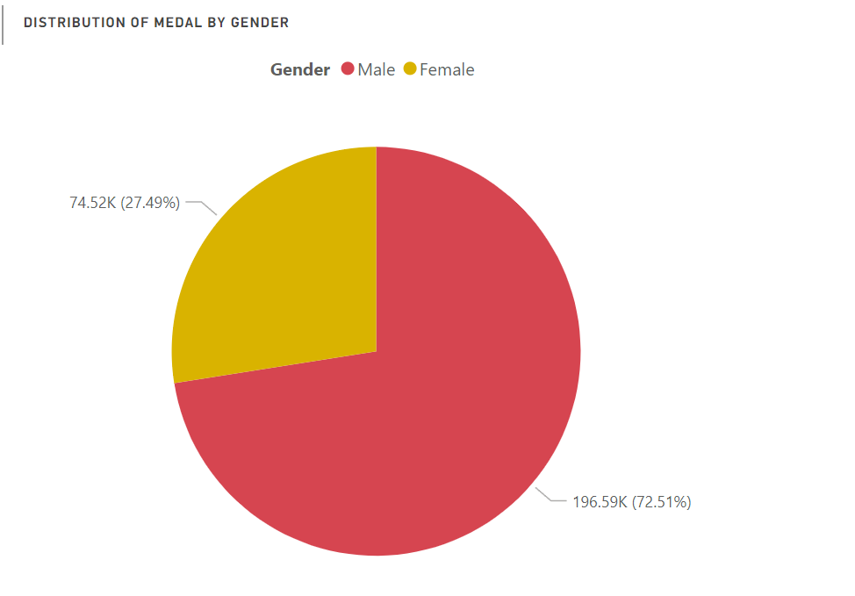
Distribution of Medals by Gender
72.51% of Medals are won by Male.
27.49% of Medals are won by Female

Slide 6
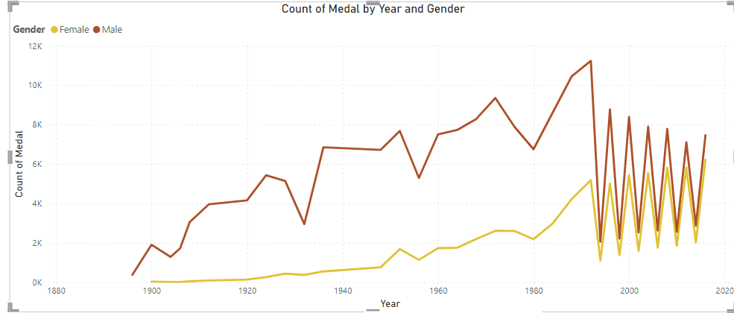
Medals Won by Males:
More medals won by males until 1992.
A sudden drop in 1994.
Subsequent improvement in the next Olympic season.
Medals Won by Females:
Lower number of medals initially.
Significant effort to catch up in 2016.
Visual representation in the graph highlights the evolving trend.

Slide 7
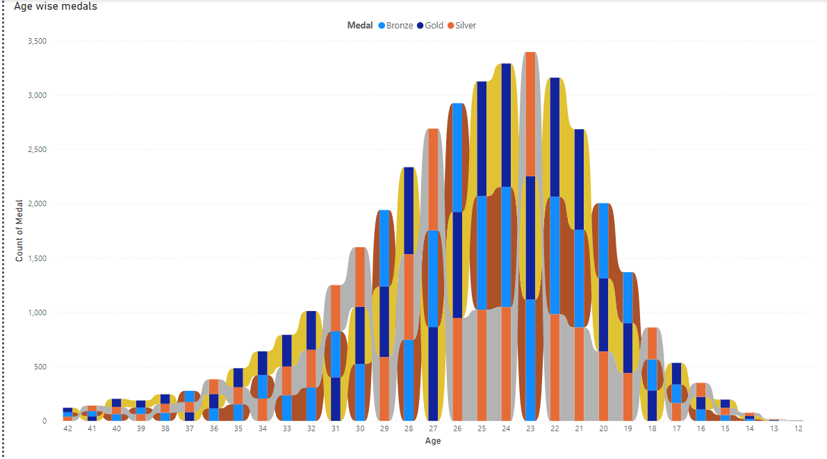
Ribbon graph provides a visual representation of medal distribution across different age groups in the Olympics.
It helps to Examine trends in medal achievements based on age categories.

Slide 8
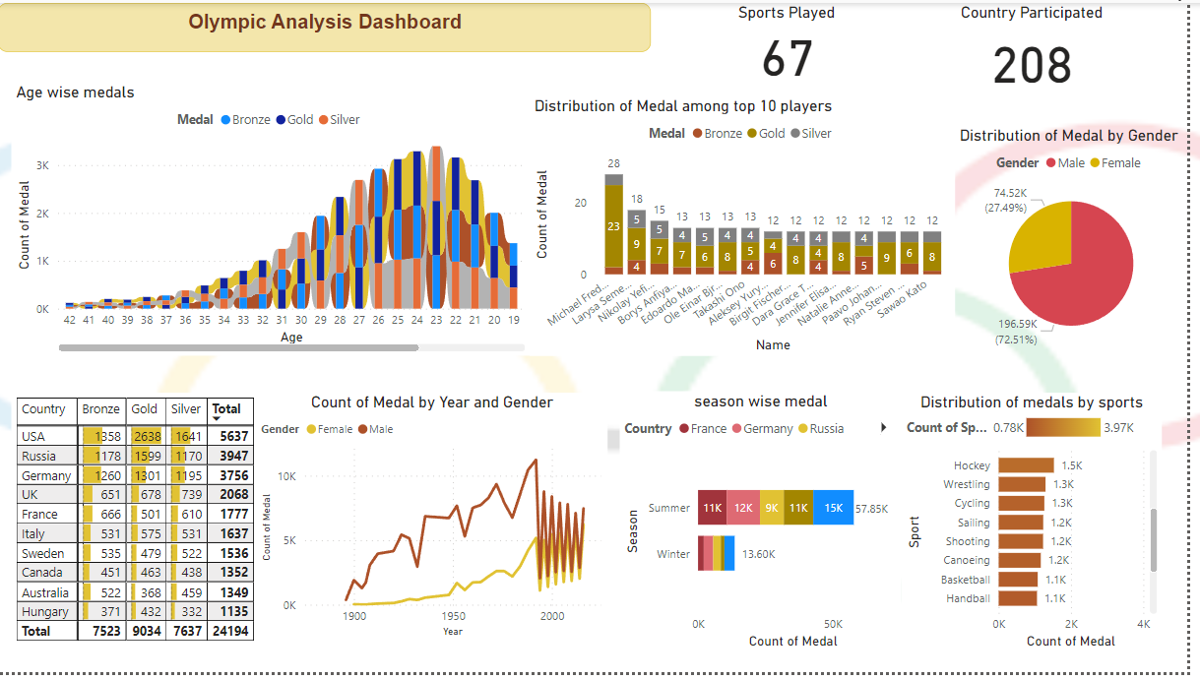

Slide 9

The PowerPoint presentation serves as an interactive dashboard for Olympic data analysis.
Enables real-time insights into Olympic statistics and trends.
Users can dynamically explore and analyze age-wise medal distribution, Gender wise, Season Wise directly from the presentation.

Slide 10

Thank YOU

